Slide 1

Introduction Welcome to this presentation on Noise Pollution Monitoring. Noise pollution is a growing concern in urban and industrialized areas. This presentation will explore the importance of monitoring noise pollution and the methods involved.

Slide 2
Understanding Noise Pollution
Definition: Noise pollution refers to the presence of unwanted, disruptive, or harmful sound in the environment.
Sources: Traffic, industrial machinery, construction, aviation, and social activities.
Impact: Health issues, stress, hearing loss, and reduced quality of life.

Slide 3
The Need for Monitoring
Noise pollution monitoring is essential to:
Assess and control noise levels.
Ensure compliance with regulations.
Protect public health and well-being.
Identify and mitigate problem areas.

Slide 4

Components of Noise Pollution Monitoring
Noise Measurement Devices
Sound Level Meters: Measure sound intensity in decibels (dB).
Noise Dosimeters: Monitor personal exposure over time.
Acoustic Sensors: Collect data from fixed locations.
Noise Mapping Software: Create visual representations of noise levels.
Data Collection and Analysis
Continuous monitoring and recording of noise levels.
Analysis of data to identify trends, patterns, and sources of noise pollution.
Integration with Geographic Information Systems (GIS) for spatial analysis.

Slide 5
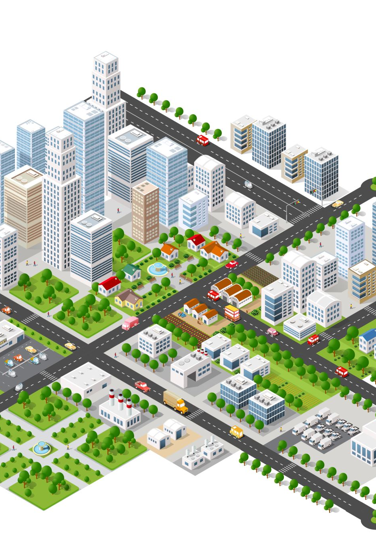
Noise Monitoring Locations
Monitoring is conducted in various settings including:
1. Urban areas
2. Highways and transportation hubs
3. Industrial zones
4. Residential neighborhoods
5. Public spaces and parks

Slide 6
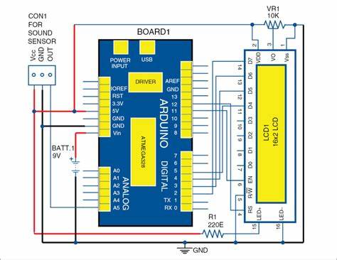
noise monitoring circuit model

Slide 7
Regulations and Standards, Real-Time Monitoring
Regulations and Standards →
Noise pollution is subject to local, national, and international regulations.
Monitoring helps ensure compliance with noise limits and guidelines.
Standards like the WHO guidelines for community noise provide benchmarks.
Real-Time Monitoring →
Advancements in technology enable real-time noise monitoring.
Data is transmitted wirelessly for immediate analysis and response.
Allows for proactive noise control measures.

Slide 8
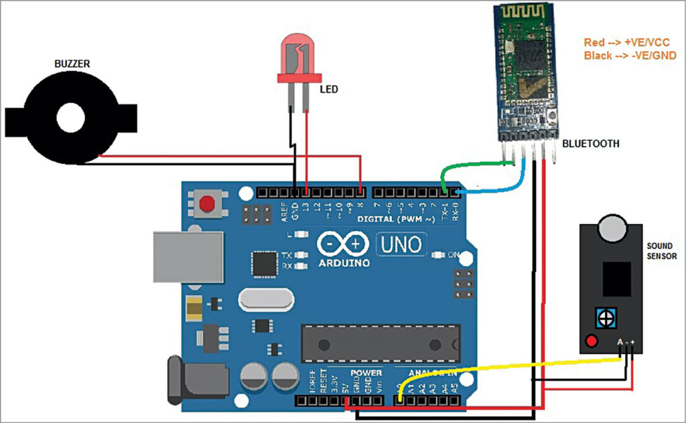
noise monitoring device circuit

Slide 9
Benefits of Noise Pollution Monitoring
Benefits of Noise Pollution Monitoring →
Improved Public Health: Reduced exposure to harmful noise levels.
Better Urban Planning: Data helps design quieter and more livable cities.
Regulatory Compliance: Ensure businesses and industries follow noise regulations.
Noise Mitigation: Identify and address sources of noise pollution.

Slide 10
Conclusion
Noise pollution monitoring is essential for a healthier, more peaceful environment.
Advances in technology and data analysis enhance our ability to combat noise pollution.
Together, we can create quieter and more sustainable communities.

